Slide 1

F.3 Summer Mathematics
Inequality

Slide 2












$$>$$
$$≥$$
$$x −3$$
$$x 8$$
e.g. $10, 13, 28…$
e.g. $−3, −2, −1…$
Greater than
Greater than or equal to
$$≤$$
$$>$$
$$x −3$$
$$x 8$$
e.g. 0, 5, 6$…$
e.g. $−3, −5, −10…$
Smaller than
Smaller than or equal to

Slide 3



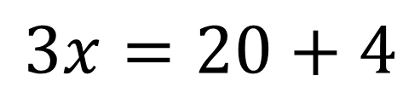



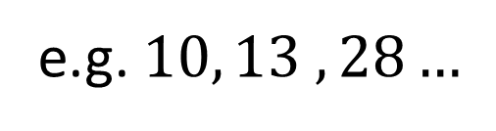


$$3x−4=20$$
$$3x−4>20$$
$$3x=20+4$$
$$3x>20+4$$
$$3x=24$$
$$3x>24$$
$$x=8$$
$$x>8$$
e.g. $10, 13 ,28…$

Slide 4





























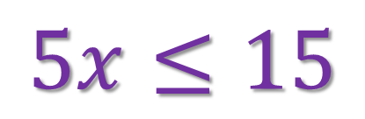




$$x$$
$$+3$$
$$<$$
$$5$$
$$+3$$
$$x$$
$$−2$$
$$10$$
$$−2$$
$$>$$
$$x$$
$$<$$
$$5$$
$$−3$$
$$x$$
$$>$$
$$10$$
$$+2$$
$$x<2$$
$$x>12$$
$$5x≤15$$
$$\frac{x}{4}≥2$$
$$5$$
$$4$$
$$\frac{15}{}$$
$$x$$
$$≤$$
$$x≥2$$
$$×4$$
$$5$$
$$x$$
$$≥$$
$$8$$
$$x≤3$$

Slide 5




















$$−\frac{x}{4}≥2$$
$$−\frac{x}{4}=2$$
$$4$$
$$4$$
$$−x≥2$$
$$×4$$
$$−x=2$$
$$×4$$
開口
尖頭
$$−x$$
$$=$$
$$−x$$
$$≥$$
$$8$$
$$8$$
$$x$$
$$=$$
$$−8$$
$$x$$
$$≤$$
$$−8$$
尖頭
開口

Slide 6


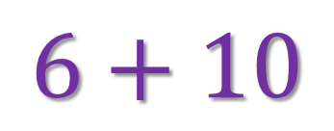
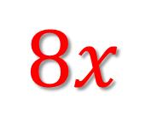


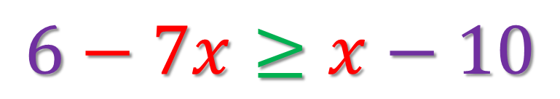

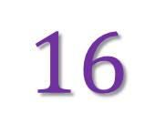


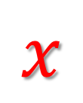

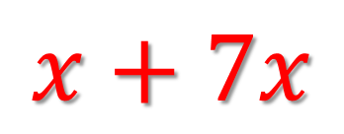
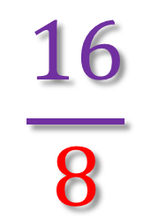

$$6−7x≥x−10$$
$$6+10$$
$$≥$$
$$x+7x$$
$$16$$
$$≥$$
$$8x$$
$$\frac{16}{8}$$
$$≥$$
$$x$$
$$2$$
$$≥$$
$$x$$
開口
尖頭
$$x$$
$$≤$$
$$2$$
尖頭
開口

Slide 7


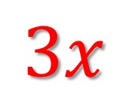
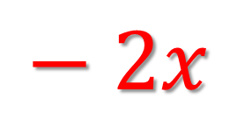
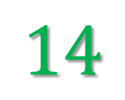
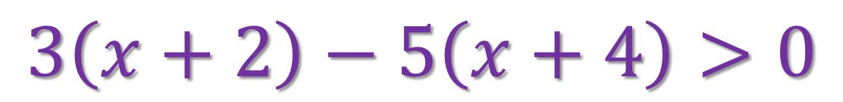
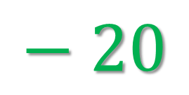



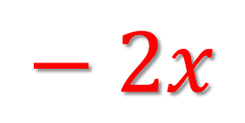
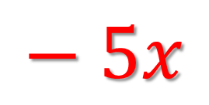

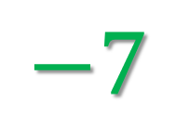

$$3\left(x+2\right)−5\left(x+4\right)>0$$
$$3x$$
$$+ 6$$
$$− 5x$$
$$− 20$$
$$>0$$
$$− 2x$$
$$−14$$
$$>0$$
$$− 2x$$
$$>$$
$$14$$
$$x$$
$$<$$
$$−7$$

Slide 8



















$$2x+1<\frac{4x+1}{3}$$
$$3$$
$$(2x+1)<4x+1$$
$$3$$
$$6x$$
$$+3$$
$$<$$
$$4x+1$$
$$4x$$
$$+ 1$$
$$6x−4x$$
$$<$$
$$+1−3$$
$$2x$$
$$<$$
$$−2$$
$$x$$
$$<$$
$$−1$$

Slide 9




$\text{Q}1\text{.}$ $x+3<7$
$$x+3−3<7−3$$
$$x+0<4$$
$$x<4$$

Slide 10



$\text{Q}11\text{.}$ $3x<15$
$$\frac{3x}{3}<\frac{15}{3}$$
$$x<5$$

Slide 11





$\text{Q}23\text{.}$ $−x+3>7$
$$−x+3−3>7−3$$
$$−x+0>4$$
$$−x>4$$
$$x<4$$

Slide 12








$\text{∗}\text{Q}13\text{.}$ $\frac{−3x+5}{2}≥\frac{11−x}{3}$
$$\frac{−3x+5}{2}×\left(2×3\right)≥\frac{11−x}{3}×\left(2×3\right)$$
$$\left(−3x+5\right)×3≥\left(11−x\right)×2$$
$$−9x+15≥22−2x$$
$$−9x+15+2x−15≥22−2x+2x−15$$
$$−7x≥7$$
$$x≤1$$

Slide 13














$$>$$
$$>$$
$$>$$
$$≥$$
$$x 2$$
$$x −3$$
e.g. $1, 1.3 ,0, −4…$
-ve
+ve
$$−2$$
$$−1$$
$$0$$
$$1$$
$$2$$
$$−3$$
$$0$$

Slide 14






$$5+2x≤−9$$
$$2x≤−9−5$$
$$2x≤−14$$
$$x≤−7$$
$$−7$$
$$0$$

Slide 15










$$13≥9x−5$$

Slide 16











$$5\left(−4x+1\right)>2\left(x−3\right)$$
乘/除負數
符號方向改變

Slide 17






























$$>$$
Dividing three times x by 7 is x minus 12. If x is a prime number, find the smallest value of x.
less than
greater than
Greater than
$$>$$
$$\frac{3x}{7}$$
$$\frac{3x}{7} x−12$$
$$<$$
$$x−12$$
$$>$$
Smaller than
$$>$$
$$3x 7x−84$$
$$>$$
$$<$$
$$3x 7x−84$$
Greater than or equal to
$$84 4x$$
$$>$$
$$<$$
$$84 4x$$
$$21 x$$
$$<$$
$$<$$
$$>$$
$$21 x$$
$$x 21$$
$$>$$
$$x 21$$
$$<$$
e.g. $22, 23,24…$
Smaller than or equal to
e.g. $20, 19, 18…$
$∴$ The value is .
$$19$$
$$23$$

Slide 18











$$>$$
If the sum of 4 and 5 times of 𝑥 is
to 10, find the minimum integral value of 𝑥.
greater than or equal
not greater than
Greater than
$$>$$
Smaller than
$$>$$
Greater than or equal to
Not smaller than
$$<$$
$∴$ The value is .
Smaller than or equal to
Not greater than

Slide 19









$$>$$
There are 10 green balls and some red balls in a bag. If the number of green balls is less than three times the number of red balls by at least 7, at least how many red balls are there in the bag?
Greater than
$$>$$
Smaller than
$$>$$
Let $x$ be the number of red balls in the bag.
Greater than or equal to
Not smaller than
At least
$$<$$
Smaller than or equal to
$∴$ The value is .
Not greater than
At most

Slide 20















$$>$$
$$>$$
$$<$$
$$>$$
Greater than or equal to
Greater than
Smaller than
Smaller than or equal to
Not smaller than
Not greater than
At least
At most
$$x 2$$
$$x −3$$
$$>$$
$$≥$$
乘/除負數
符號方向改變
$$0$$
$$2$$
$$−3$$
$$0$$

